Slide 1
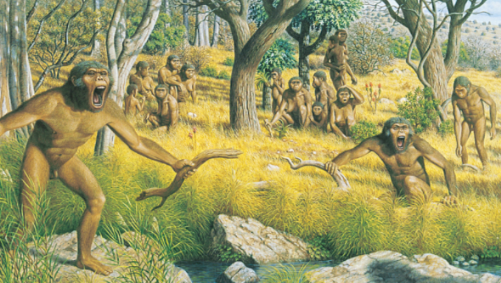
Human Ancestors: Australopithecus
Habitat and Behaviour
Fossil Record
Anatomical Features

Slide 2
Date: | Human Biology Year 12 ATAR
Do Now Past exam question Hand in review worksheet Lesson Agenda 1: Do Now 2: Human Ancestors – Australopithecus 3: Lesson summary and windup Suggested Study Read through today’s notes and textbook section Complete review worksheet, then mark and correct using the answer key on Connect (compulsory). NEXT LESSON Homo habilis Homo erectus | Learning Aims Describe the main features of Australopithecines Describe the fossil record for Australopithecines Describe the following anatomical features of Australopithecines and compare these to modern day Great Apes and Humans: General skeletal structure Dentition Skull Femur and Pelvis
 | Key Vocabulary Australopithecine Australopithecus Paranthropus Sagittal Crest

Slide 3
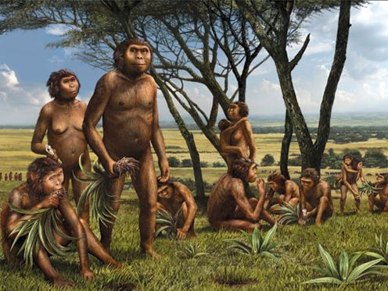
Australopithecines – Overview
Lived 3-4 million years ago in East Africa.
Likely several species
Direct ancestor to humans but also to other extinct hominids – some on other “branches” of the evolutionary tree.
Were bipedal (walked on two legs)
Lived in family groups
Spent time in trees and on ground
Mostly vegetarian
Used rocks and sticks to forage (eg fishing for ants) and *may* have made simple stone tools, but this is debated among experts
No evidence of fire use, building of structures, making of art, use of language or abstract thought.
Learning Aim: Describe the main features of Australopithecines

Slide 4
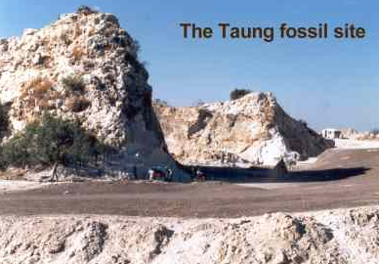
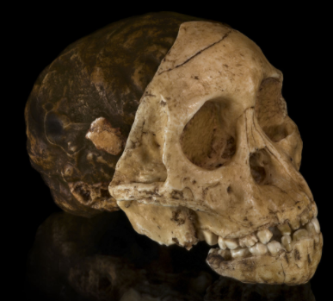
Australopithecines – Fossil Record
First fossil found in early 1920s
Raymond Dart (an Aussie!)
Found in the limeworks at Taung
Realised skull was not of an ape
Juvenile skull of a hominin
Need to be cautious about juvenile skulls - naturally more rounded
Jaws and teeth were also different
Foramen magnum positioning
Concluded that the skull was from an ancestral hominin
“Taung Child” – named Australopithecus africanus
Learning Aim: Describe the fossil record for Australopithecines

Slide 5
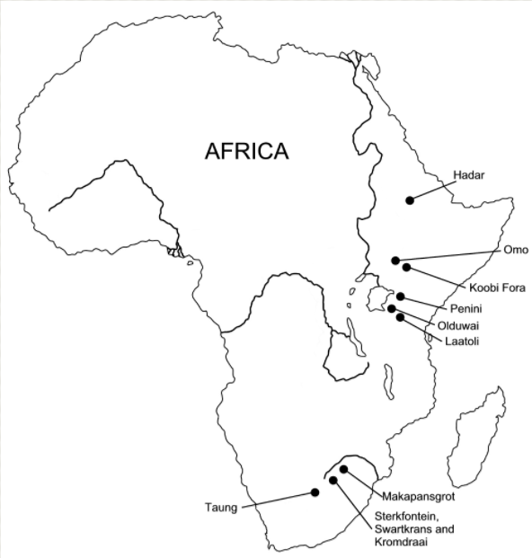
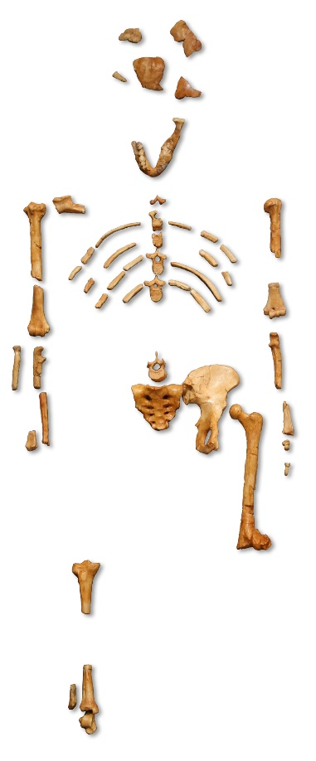
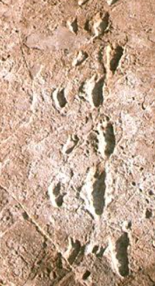
Australopithecines – Fossil Record
Further fossils found
By Robert Broom, at Sterkfontein, in 1930s
Different fossil found at Kromdraai – Paranthropus robustus
1974: “Lucy” found in Hadar region of Ethiopia
40% complete female skeleton
3-3.6 million years old
Australopithecus afarensis
Shows short, broad pelvis, and carrying angle of femur that indicate bipedalism
Laetoli footprints
3 hominids walked across wet volcanic ash Australopithecus afarensis
Left behind footprints showing bipedal locomotion
3.6 million years ago
Learning Aim: Describe the fossil record for Australopithecines

Slide 6
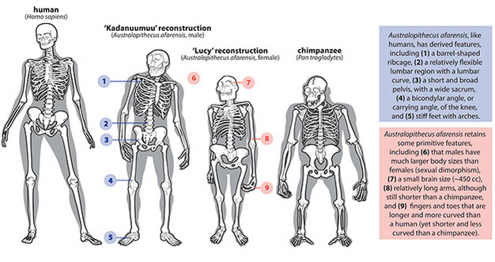
Australopithecines – Comparison to Humans and other Apes
Learning Aim: Describe the fossil record for Australopithecines

Slide 7
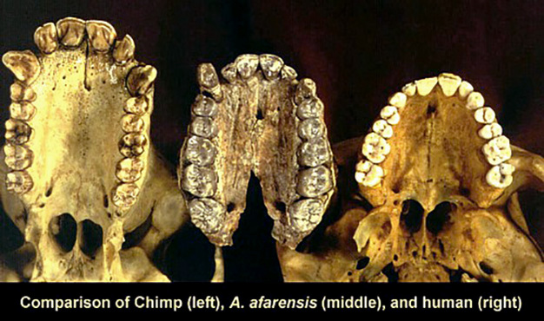
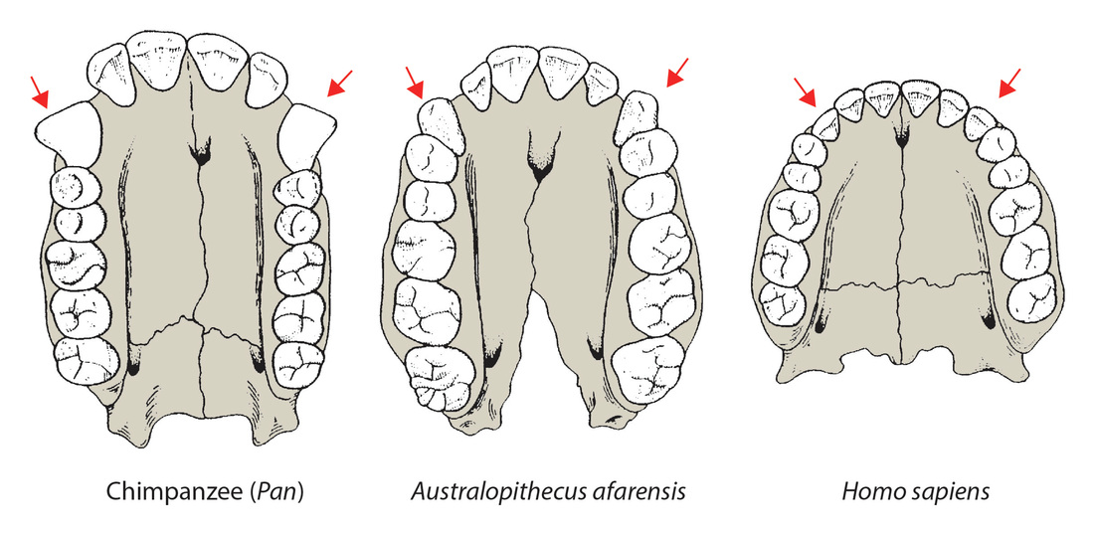
Australopithecines – Anatomical Features - Dentition
Chimp | Australopithecus | Human
Large canine teeth Diastema present U-shaped dental arcade | Canines shorter than chimp, larger than human, non projecting Small diastema present Dental arcade becoming parabolic Teeth much larger than human – indicates plant based diet. | Canines small No diastema Parabolic dental arcade Teeth small – indicates omnivorous diet and less prognathism.
Learning Aim: Describe dentition of Australopithecines and compare to modern apes and humans

Slide 8
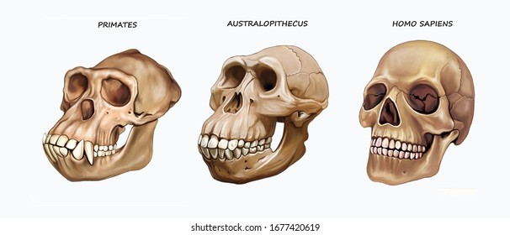
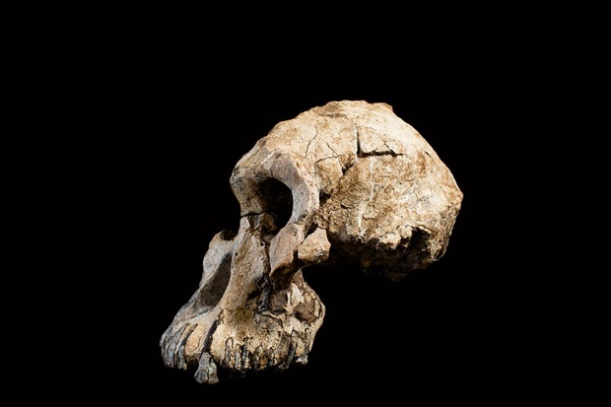
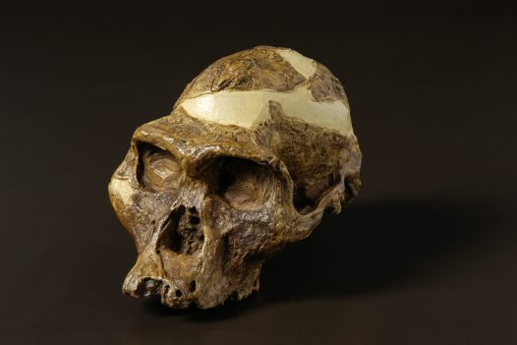
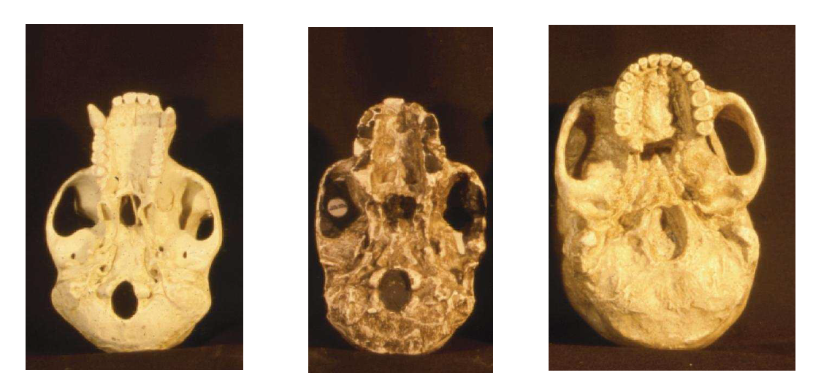
Australopithecines – Anatomical Features – Skull
Facial profile
Lower forehead, more projecting jaw than more modern hominins
Brain size 480cc, closer to modern gorilla than human
Relative brain size larger though: Australopithecus smaller than gorilla
Brain size and anatomy
Brain size 480cc, closer to modern gorilla than human
Relative brain size larger though: Australopithecus is smaller than gorilla
Endocasts show brain more similar to humans in structure
Foramen magnum more forward than in apes
Skull more rounded in back than in apes
Learning Aim: Describe the skull of Australopithecines and compare to modern apes and humans

Slide 9
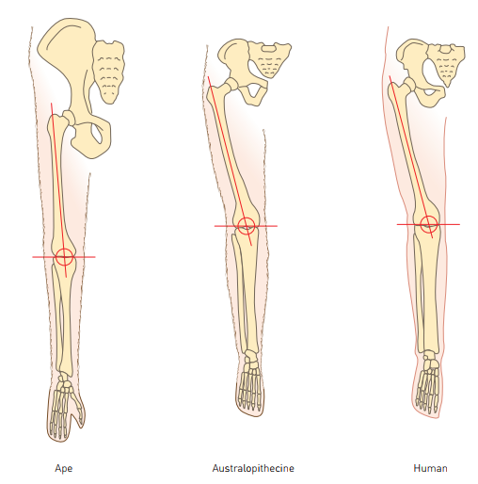
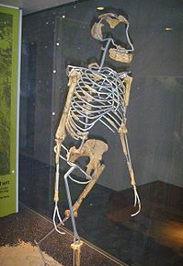
Australopithecines - Anatomical Features - Limb bones
Footprints show bipedal gait, although not quite the same as modern humans
Pelvis and carrying angle more similar to modern humans than to apes
Limb bones
Suggest bipedal locomotion
Pelvic and foot bones typically hominin
Non opposable, strongly built big toe
Thumb less mobile than modern humans, but more so than modern apes
Vertebral column – typically hominin curves
Foramen magnum – at base of skull.
Learning Aim: Describe the femur and pelvis of Australopithecines and compare to modern apes and humans

Slide 10
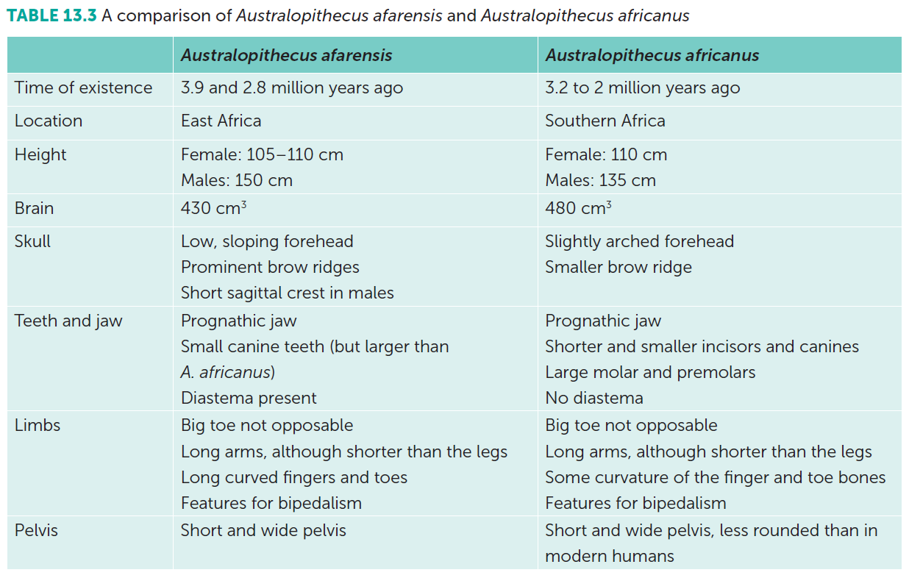
Evolutionary Progression in Australopithecines
More than one species of Australopithecine.
Australopithecus afarensis – earlier
Australopithecus africanus – later
Can see evolutionary transition between the two species:
Learning Aim: Discuss features that demonstrate evolutionary progession within the Australopithecus genus.

Slide 11
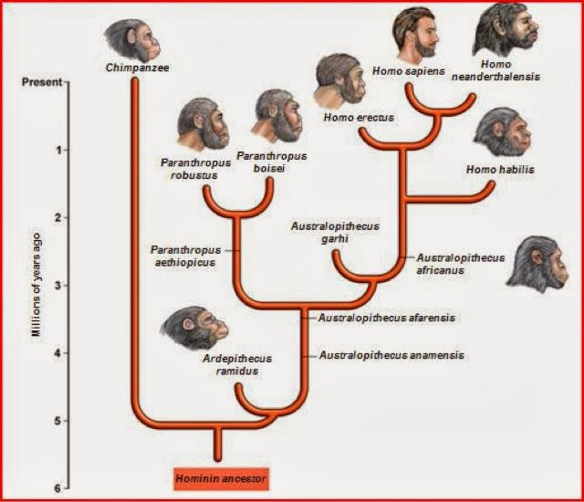
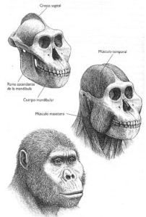
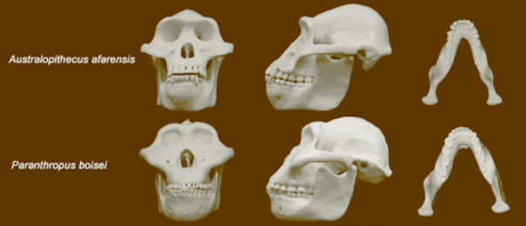
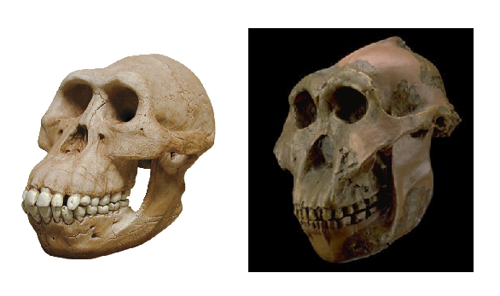
Paranthropus robustus
Closely related to Australopithecus
Paranthropus used to be classified as Australopithecus.
Different branch of the evolutionary tree.
Australopithecus | Paranthropus robustus
120-140cm tall | Up to 170cm tall
25-35 kg | Up to 70 kg
Proportional molars | Larger, broader molars
Smaller jaw muscles | Large jaw muscles and attachments, and sagittal crest
Australopithecus africanus Australopithecus afarensis Used to be classified as “gracile” Australopithecus | Paranthropus robustus used to be classified as “robust” Australopithecus
Learning Aim: Describe differences between Australopithecus and the closely related Paranthropus.

Slide 12
